Slide 1
Build your own .NET Aspire integrations
Aaron Powell & David Pine

Slide 2
01
Types of integrations

Slide 3




















Two types of integrations
Hosting integrations
Client integrations
Adds to the app host project.
Something that needs to be “started”.
Used as a reference to other resources.
Connection to something provided by the app host.
Default configuration for the connection.
Registers itself with the DI container.

Slide 4
02
Introducing the .NET Aspire Community Toolkit

Slide 5
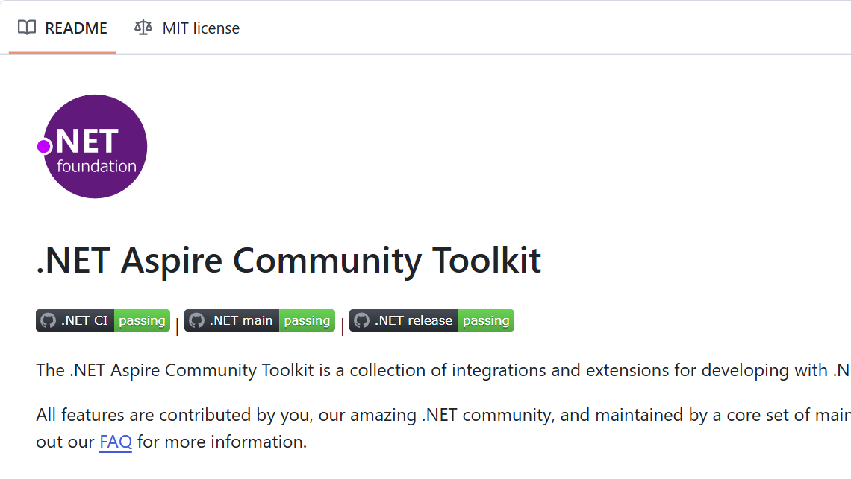

.NET Aspire Community Toolkit
Collaborate
Custom integrations for .NET Aspire.
Open Source.
A .NET Foundation project.
Community focused.
https://aka.ms/communitytoolkit/aspire

Slide 6

Demo: Let’s create an integration
Aaron & David dive into VS Code to build an integration

Slide 7
🔗 Resources
Announcement blog
GitHub Repo
Docs
aka.ms/communitytoolkit/aspire/blog
aka.ms/communitytoolkit/aspire
aka.ms/communitytoolkit/aspire/docs
.NET Aspire
Hosting Integration
Client Integration
aka.ms/dotnet/aspire
aka.ms/dotnet/aspire/hosting-integration
aka.ms/dotnet/aspire/client-integration

Slide 8

Get .NET 9
Download .NET 9 aka.ms/get-dotnet-9

